Slide 1
ERD to Hibernate

Slide 2
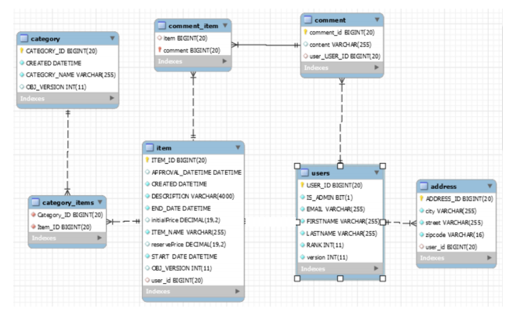
First let’s identify the associations between the tables from the diagram

Slide 3
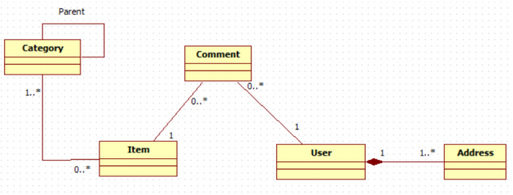
There are 5 associations in this diagram. /Association between users and item tables is blurred for some reason but it’s there because there is user_id field in the item table.
2
3
1
 | Identified association from the diagram or interesting part of the diagram. | Is tables joined by table or column? Which means join column or join table? | Logical meaning of the association? | What kind of relation it mean?
1 | category_items | Join Table | Item has many Categories Categories has many Items | ManyToMany Join table
2 | comment_items | Join Table | Many comments have One Item One Item has many Comments | ManyToOne & OneToMany Join Table
3 | Comment.user_USER_ID | Join Column | One User has Many Comments Many Comments belong to One User | OneToMany & ManyToOne Join Column
4 | Address.user_id | Join Column | One User has Many Address Many Address belong to One User | OneToMany & ManyToOne Join Column
5 | Item.user_id | Join Column | One User has Many Item Many Item belong to One User | OneToMany & ManyToOne Join Column
4
5

